Slide 1

Firefighter Rehab Training
Shepherdstown Fire Department, Inc.
Educational Institution
April 2019

Slide 2

Agenda
Standard for Rehabilitation Establishment
Standard for Personnel Reporting to Rehab
Standard for Location of Rehab
Standard for Minimum Rehab Resources
Standard for Rehab Monitoring
Standard for “Treat and Release” per the Medical Director
Standard for Denial of Return to Duty
Standard for Return to Duty
Standard to Transport to Hospital for Evaluation, Automatic Transport Criteria (ATC)

Slide 3

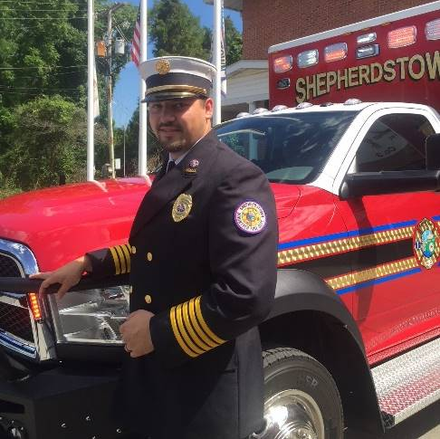
Marshall DeMeritt, MS, NREMT
  Grew up on a goat farm in Luray, VA
  Undergraduate Degree from Shepherd University
  Joined Shepherdstown Fire Department in 2006
  Elected as EMS Chief in 2014
  Master of Science from WVU
  WV Office of EMS Emergency Medical Technician
  National Registry Emergency Medical Technician
  National Association of EMS Educators Instructor
  WV Office of EMS Lead Instructor
  Firefighter, Fire Officer II, and Rescue Technician
  Father of 3 (2 + a dog), Husband to Krystle

Slide 4
Purpose
This training is to provide Jefferson County Fire and EMS personnel and Incident Commanders with direction on the implementation and use of Firefighter Rehabilitation at the scene of fires, other emergency incident scenes, and during training, per NFPA 1584 (2008).
It shall provide direction as to what activities are to be undertaken by each component of the fire ground and the EMS providers assigned to work in the rehab sector.
These guideline used to develop this training (OG 16-018) includes when to restrict members from returning to duty for medical reasons and when to transport for additional treatment. It shall also provide guidance to those members reporting to rehab as to what their responsibilities are, and what to expect of the process.

Slide 5
Standard for Rehabilitation Establishment
Shepherdstown Fire Department
Educational Institution

Slide 6
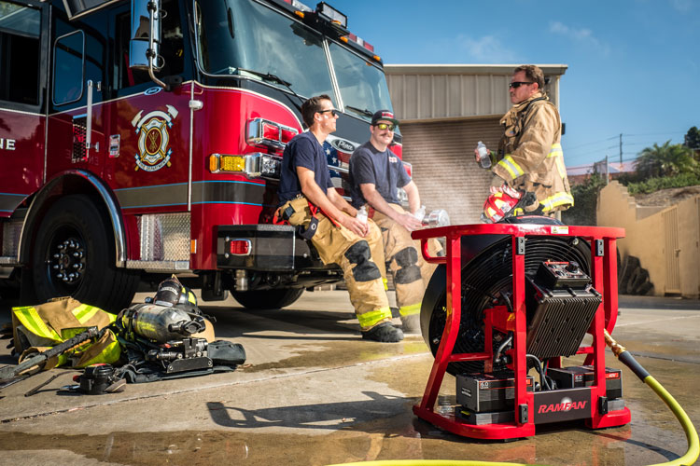
Rehabilitation Establishment
Formal Rehabilitation should be established on all incidents in which one or more of the following are present:
  Operational period greater than forty-five (45) minutes.
  Greater than twenty (20) Operational Personnel on scene.
  Any incident in which an area (sector) has been determined Immediately Dangerous to Life and Health (IDLH).
  At the discretion of the Incident Commander or commanding officer.

Slide 7
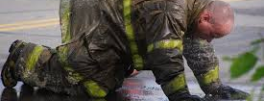
Company/Unit officers shall monitor members under their command
Members shall also monitor themselves and each other even without the formality of a rehabilitation program.
Members should request rehab from their company/unit officer if they feel they are in need (illnesses, injuries, or other conditions).
Company/Unit officers should request rehab be established if they feel their company member(s) are in need.
Do not let a lack of formal rehab keep Illnesses, injuries, or other conditions from being reported immediately.

Slide 8
Standard for Location of Rehab
Shepherdstown Fire Department
Educational Institution

Slide 9
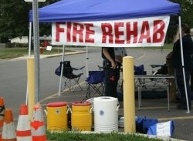
Standard for Location of Rehab
  Be away from smoke or other irritant and provide comfortable breathing conditions removed from the hazards of the incident scene including smoke, vehicle exhaust, and excess noise.
  Be completely segregated from media and spectators.
  Provide protection from weather extremes (direct sun, rain, etc).
  Be accessible to emergency medical transport vehicles.

Slide 10
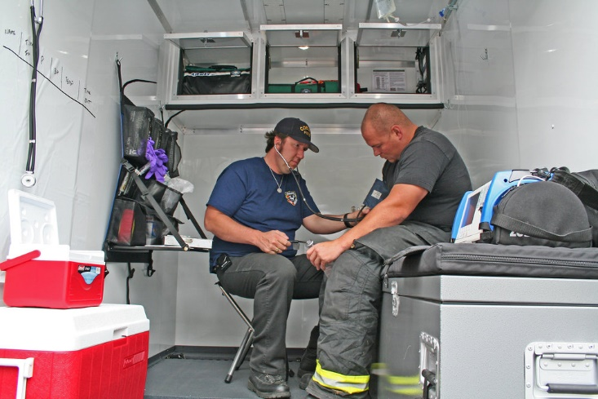
Standard for Location of Rehab
  Be of a size large enough to facilitate the expected number of personnel - including members working in the rehab area.
  Have a separate area for doffing and storing PPE, and replacing air bottles.
  Have an adequate supply of drinking water, sports drinks for electrolyte replacement and food for calorie replacement - especially during incidents longer than three hours.

Slide 11
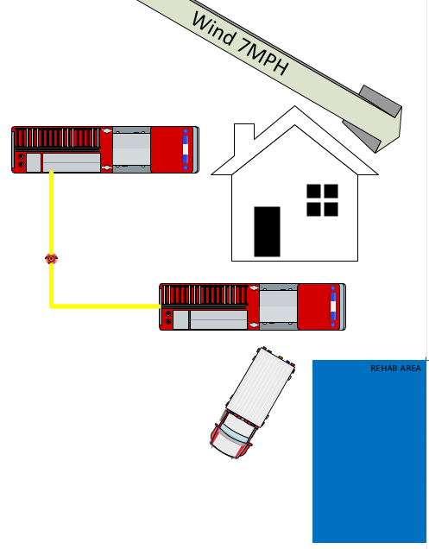


Standard for Location of Rehab
What’s Wrong Here?

Slide 12
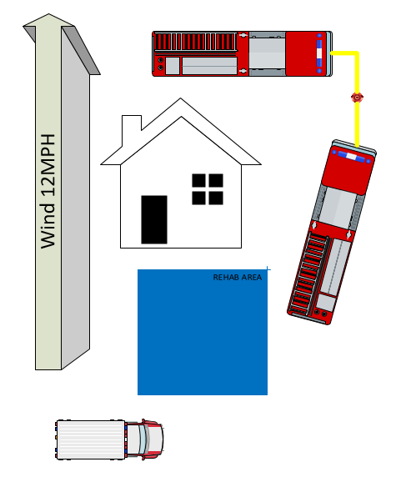
Standard for Location of Rehab
What’s Wrong Here?

Slide 13
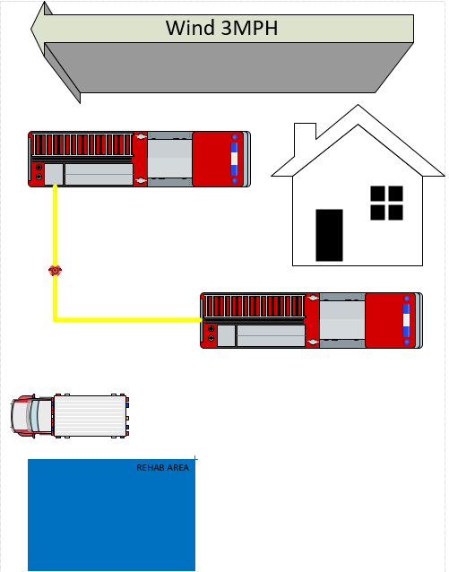
Standard for Location of Rehab
What’s Wrong Here?

Slide 14
Standard for Minimum Rehab Resources
Shepherdstown Fire Department
Educational Institution

Slide 15
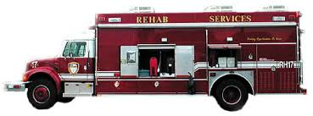
Standard for Rehab Resources
The Incident Commander, Medical Group Supervisor or Rehab Officer shall ensure the Rehab location provides for the following elements:
  Medical monitoring – At a minimum, the rehab facility shall provide a Lifepack 15 and/or the ability to monitor the blood pressure, pulse, SP02, respirations, and CO of a firefighter.
  Emergency Medical Care and Transport – At minimum, the rehab location will provide general care and treatment tools for the treatment of basic medical emergencies and traumatic injuries (AED, trauma dressings, Oxygen, etc).
  Immediate access to an Ambulance.
  Hydration to replace lost fluids - Members should drink at least 8-16 oz. water or electrolyte sports drink in the 20 minutes they are in rehab.
  Cooling and/or Warming capabilities.
  Relief from weather extremes (heat, cold, direct sun, rain, snow, wind)
  Food shall be provided during incidents lasting in excess of 3 hours.
  Accountability - Individual units are to report to rehab as a group, and are to remain together during rehab. All personnel reporting to rehab should be documented for accountability purposes.

Slide 16
Standard for Personnel Reporting to Rehab
Shepherdstown Fire Department
Educational Institution

Slide 17
Standard for Personnel Reporting to Rehab
All personnel operating within an area that is deemed as IDLH must report to rehab within the confines of the incident operations period, and preferably immediately upon exiting the IDLH.
Any personnel completing one (1) hour of SCBA use should report to rehab.
It is the responsibility of the Incident Commander, and the unit officer to ensure all personnel have reported to rehab.
The Rehab Officer or Medical Group Supervisor must ensure appropriate tracking and documentation of all personnel reporting to rehab.

Slide 18
Why Report to Rehab?
County Standard dictates your compliance.
A report by the Illinois Fire Service Institute (IFSI) documents a firefighters’ average heart rate when exerting themselves during overhaul: 175 bpm
Further, the IFSI report suggests that firefighters lose nearly two quarts of sweat per hour when firefighting.
Firefighter rehab, along with a healthy lifestyle and diet, could go a long way toward reducing fatalities and injuries.

Slide 19
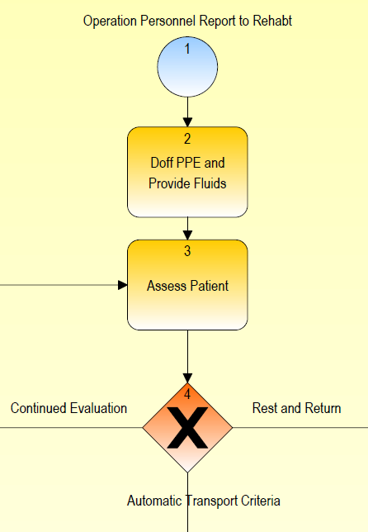
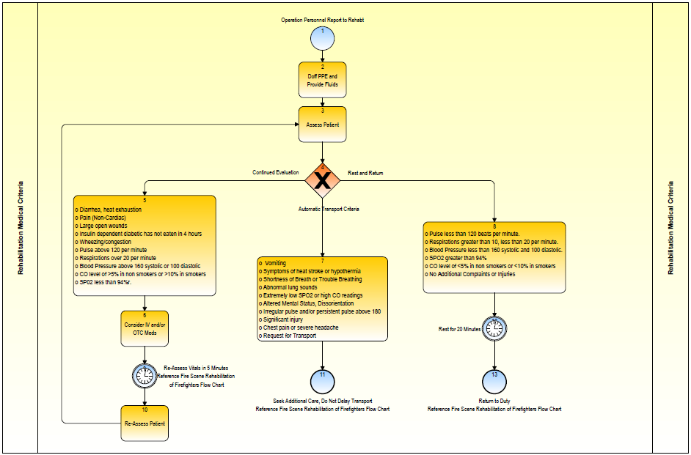

Slide 20
Standard for Rehab Monitoring
Shepherdstown Fire Department
Educational Institution

Slide 21
Standard for Rehab Monitoring
The Incident Commander, Medical Group Supervisor or Rehab Officer shall ensure the EMS providers facilitating rehab provide the following monitoring:
  Members shall be checked into rehab by EMS workers in the rehab sector and shall have their department, unit, name, and the time of entry recorded on the EMS REHAB FORM.
  Vitals shall be recorded on the EMS REHAB FORM.
    Vital signs and assessments made will include blood pressure, pulse, SP02/CO, and Temp. Presence of any trauma and/or other conditions will be noted on the form, and appropriate care established.
  EMS providers will perform a basic medical and trauma assessment on all personnel entering rehab, and document any findings.

Slide 22
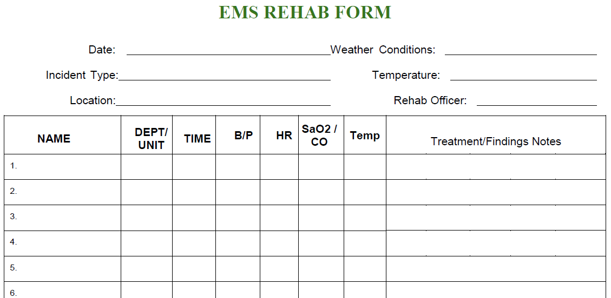

Slide 23
Standard for Return to Duty
Shepherdstown Fire Department
Educational Institution

Slide 24
Standard for Rehab Monitoring
All Members will be required to maintain a presence in rehab for 20 minutes of monitoring, or until emergency operations have ceased, whichever is sooner.
If after a 20 minute monitoring period the member exhibits appropriate signs and symptoms, they shall be released to return to full duty:
  Pulse less than 120 beats per minute.
  Respirations greater than 10, less than 20 per minute.
  Blood Pressure less than 160 systolic and 100 diastolic.
  SPO2 greater than 94%
  CO level of <5% in nonsmokers or <10% in smokers

Slide 25
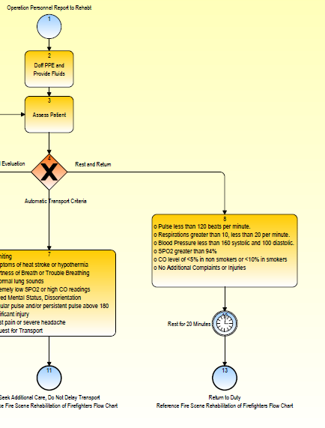

Slide 26

Standard for Rehab Monitoring
The Medical Group Supervisor or Rehab Officer shall collect the documentation from the EMS providers, and will complete a single ePCR within “ESO” to document the Rehab completion. The forms utilized in the completion of Rehab will be scanned and attached to the ePCR.
  NOTE: In the event a firefighter is transport from the scene, a ePCR must be completed for the transport, and a separate ePCR for the rehab operations.

Slide 27
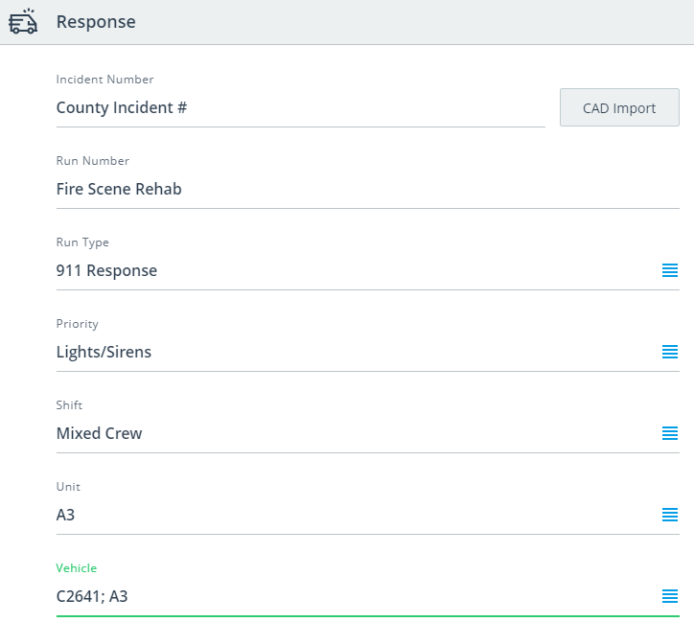
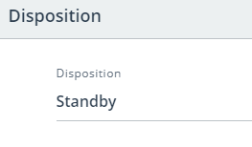

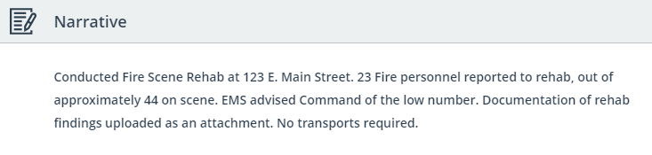

Slide 28
Standard for “Treat and Release”
Shepherdstown Fire Department
Educational Institution

Slide 29
Standard for “Treat and Release”
Per the Medical Director, Paramedics have the authority to begin IV therapy to personnel in Rehab, without the requirements to transport under the following conditions:
  The firefighter is able to orally hydrate simultaneously to the IV NS.
  After 1L NS is administered, the firefighter conditions have improved.
  Per the Medical Director, EMS providers can provide personnel in rehab Oxygen and certain Over-The-Counter (OTC) medications without the obligation to transport.
    OTC medications such as Tylenol or Motrin for the treatment of minor aches and pains.
    Oxygen for the treatment of minor respiratory issues, with an improvement in vitals following administration.

Slide 30
Standard for Denial of Return to Duty
Shepherdstown Fire Department
Educational Institution

Slide 31
Standard for Denial to Return
The Medical Group Supervisor, Rehab Officer or EMS Provider, with the authority of the Incident Commander, shall remove any firefighter from active duty if any of the following are determined:
  Vomiting, diarrhea, heat exhaustion
  Large open wounds
  Insulin dependent diabetic has not eaten in 4 hours
  Wheezing/congestion, unimproved by oxygen
  Pulse above 120 per minute after 20 minutes of rest.
  Respirations over 20 per minute after 20 minutes of rest.
  Blood Pressure above 160 systolic or 100 diastolic after 20 minutes rest.CO level of >5% in nonsmokers or >10% in smokers after 20 minutes of rest.
  SP02 less than 94% after 20 minutes of rest.
  Other conditions as appropriate, at the discretion of Medical Group Supervisor, Rehab Officer or EMS Provider.

Slide 32
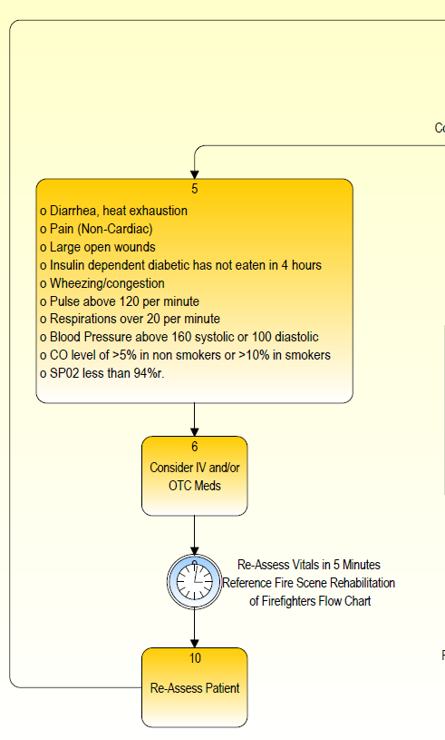

Slide 33
Standard for Denial to Return
In the event any of the listed signs/symptoms are present, the MBR shall have vitals/assessments re-assessed every 5 minutes to determine appropriate additional actions.
Any member not meeting specific health criteria shall not be permitted to return to the incident and will be further monitored or transported.

Slide 34
Standard for Automatic Transport (ATC)
Shepherdstown Fire Department
Educational Institution

Slide 35
Standard for ATC
The Medical Group Supervisor, Rehab Officer or EMS Provider, with the authority of the Incident Commander, shall direct the transport of any firefighter from the scene to a Emergency Department if any of the following are determined:
  Symptoms of heat stroke or hypothermia
  Continued Shortness of Breath or Trouble Breathing
  Abnormal lung sounds or extremely low SPO2 or high CO readings
  Syncope, altered mental status, confusion, disorientation
  Irregular pulse and/or persistent pulse above 180
  Significant injury (fracture, uncontrolled bleeding, etc.)
  Chest pain or severe headache
  No improvement in other noted vitals or signs/symptoms after 20 minutes.

Slide 36
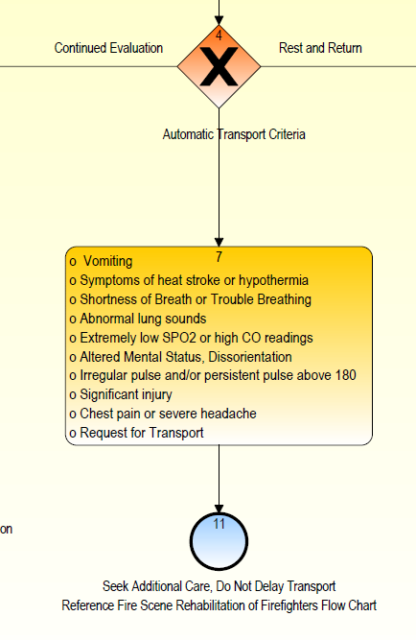

Slide 37
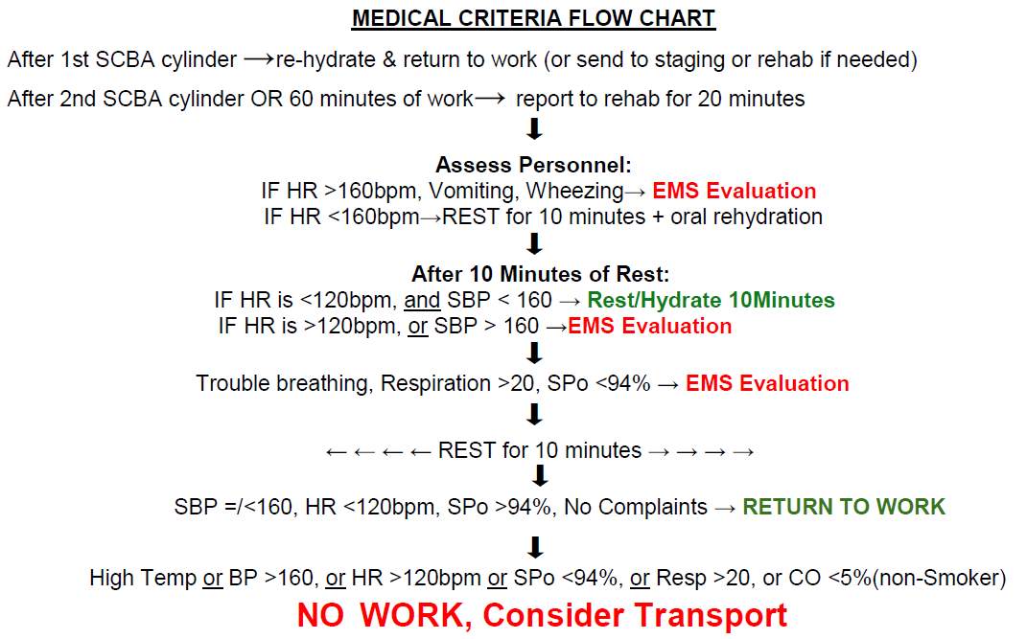
Summary

Slide 38
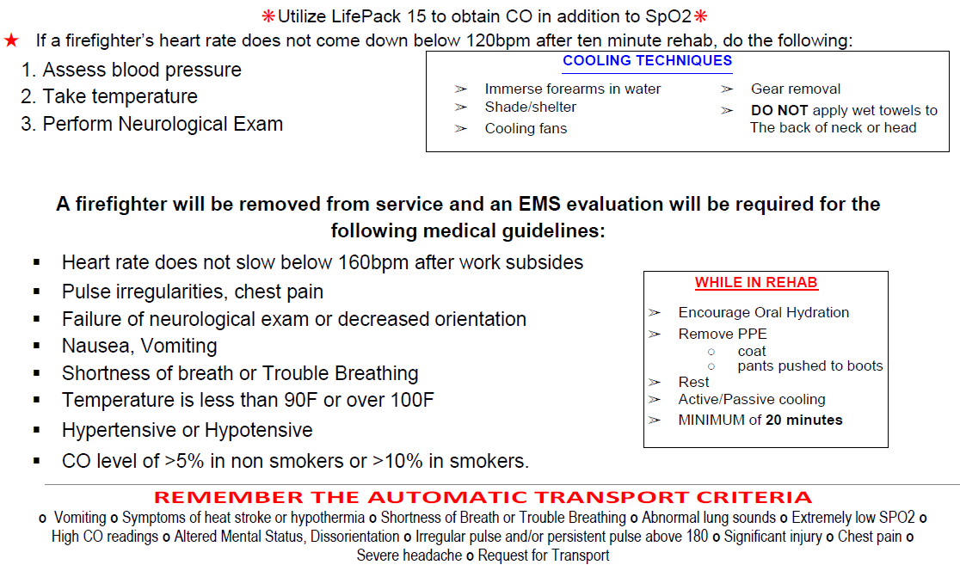
Summary

Slide 39
At no time should this guideline or training supersede the local EMS protocols or other directives from the Squad Medical Director

Slide 40
Questions?
Shepherdstown Fire Department
Educational Institution
Contact Information:
Marshall DeMeritt, MS, NREMT
EMS Chief, Shepherdstown Fire Department
emschief@shepherdstownfiredepartment.com
(540)742-8190

