Slide 1
Emergency Scene Accountability Training
Jefferson County Fire and Rescue Association
2019

Slide 2
Agenda
Purpose and Introduction
Implement “Accountability”
Jefferson County’s Accountability System Components
  Identification
  Helmet Colors
  Helmet Shields
  SCBA Identification
System Features and Advantages
Accountability Procedures
Termination Accountability
Next Steps

Slide 3
Purpose and Introduction
To define a system of emergency incident personnel accountability to account for all firefighters, EMS personnel, and/or other emergency support personnel at any time throughout the emergency occurrence.
Use of a Personnel Accountability System will provide enhanced safety for the on scene personnel, and will provide the incident command organization staff an improved means to track and account for all personnel on scene.
Review County OG: Emergency Scene Personnel Accountability

Slide 4
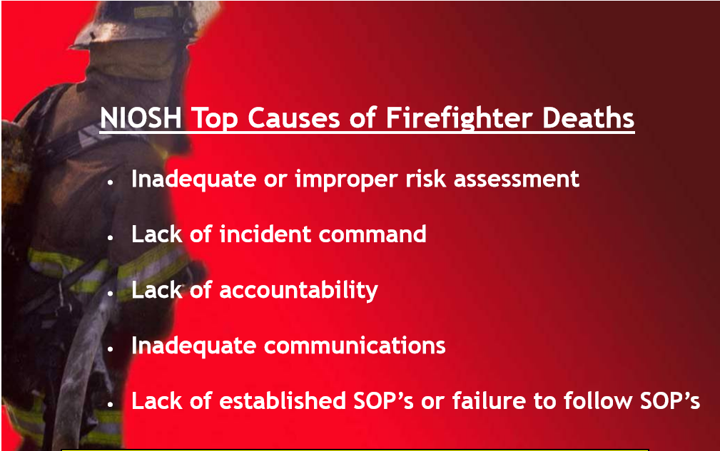
Purpose and Introduction Continued
According to NIOSH reports, lack of firefighter accountability is one of the top five causes of firefighter deaths.
Using accountability systems is mandated by NFPA 1500: Standard on Fire Department Occupational Safety and Health Program, NFPA 1521: Standard for Fire Department Safety Officer and NFPA 1561: Standard for Emergency Incident Management Systems.

Slide 5
Can we save a life?
Deputy Chief Larry Anderson (ret.): “The Dallas Fire Department was suppose to use a passport accountability system. Getting used to the routine was the toughest part, and no one did. During my 30 years with DFD, we have lost six firefighters in structure fires that I firmly believe died because we did not know who was who. We had no system to know who was with us.”
Dr. Burt Clark with the National Fire Academy once said, “You can’t engineer your way out of bad human behavior.”
Buy In and Commitment to the program is vital for success.

Slide 6
Implement accountability
Currently, we view accountability as separate from the incident action plan. It’s almost an afterthought—like setting up traffic cones around the apparatus. Firefighters and companies must be tracked when the tactical assignments are made—not after the fact.
If you can’t tell who every firefighter and company is on the fireground at any given time, you don’t have an accountability system.
If you can’t tell where a firefighter is when a mayday is transmitted or a sudden catastrophic event happens, then you don’t have an accountability system.

Slide 7
Implement accountability
Every accountability system must give you the following information:
  Firefighter’s name
  Unit or company
  Location on fireground
Accountability should be rooted in our organized response process.

Slide 8
Implement Accountability
Accountability involves a personal commitment to work within the safety system at an incident.
  Responders must hold other responders accountable to the system.
  Officers must commit to ensure their crews use the system.
  It will be the responsibility of individual personnel at the incident to keep their officer and command staff informed of their activities and whereabouts.

Slide 9
Accountability System Components
Jefferson County Fire and Rescue Association

Slide 10
Accountability ID Card
Helmet Color
Helmet Shield
Accountability System
Name Plate on Coat
Accountability Board
Unit Shield Insert
SCBA Identifier

Slide 11
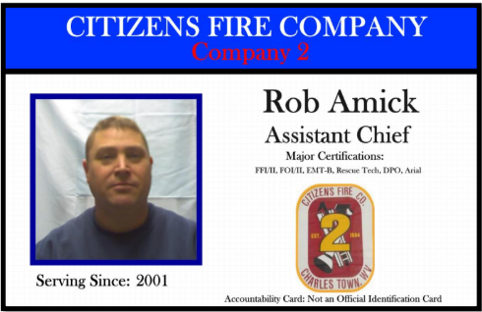
Identification of Personnel
Accountability Card
All operationally cleared interior firefighters and EMS responders within Jefferson County shall be provided by their department an Accountability Identification (also referred to as an Accountability Card, Accountability Tag, PASSPORT). This identification shall, at a minimum, include:
  Last Name
  First Initial
  Department
Ideally, the Accountability Identification should also include:
  Rank and/or Operational Capabilities
  Emergency Contact Information
  Pertinent Medical History, Allergies
  Picture

Slide 12
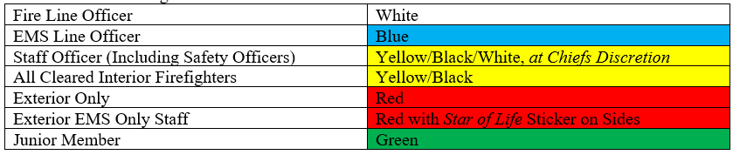
Helmet Colors
Helmets shall be from an NFPA approved manufacturer, within reasonable condition.
Helmets shall be a certain color directly related to the rank of the individual to which the helmet is assigned:
Jefferson County OG 16-10

Slide 13
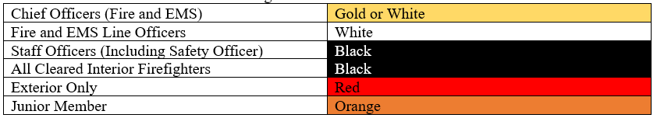
Helmet Shields
Shields, or helmet fronts, shall be a certain color directly related to the rank of the individual to which the helmet shield is assigned:
All helmet shields shall have the Individual Rank (Firefighter, Fire Chief, etc.) and Last Name. Individuals may choose to have a first initial added as well (J. Doe).
All helmet shields shall have a Velcro center area for use with a shield insert compatible with the Accountability requirements established in OG #16-14.
Jefferson County OG 16-10

Slide 14
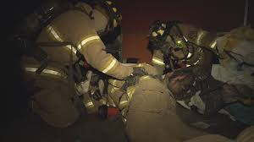
Helmet shields
Rank is printed in the top “panel” of the shield
  Captain, Lieutenant, Firefighter, Etc
Last name is printed in the bottom “panel” of the shield
Identify a lost or trapped firefighter by name.

Slide 15
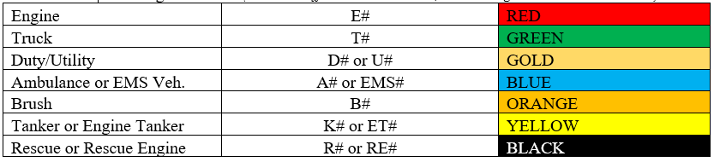
Shield Inserts
All apparatus shall have shield inserts specific to that apparatus. Shield inserts shall conform to the following standards:
(Note: Unit Officer insert will be White, with lettering colored as described above)
Jefferson County OG 16-10

Slide 16
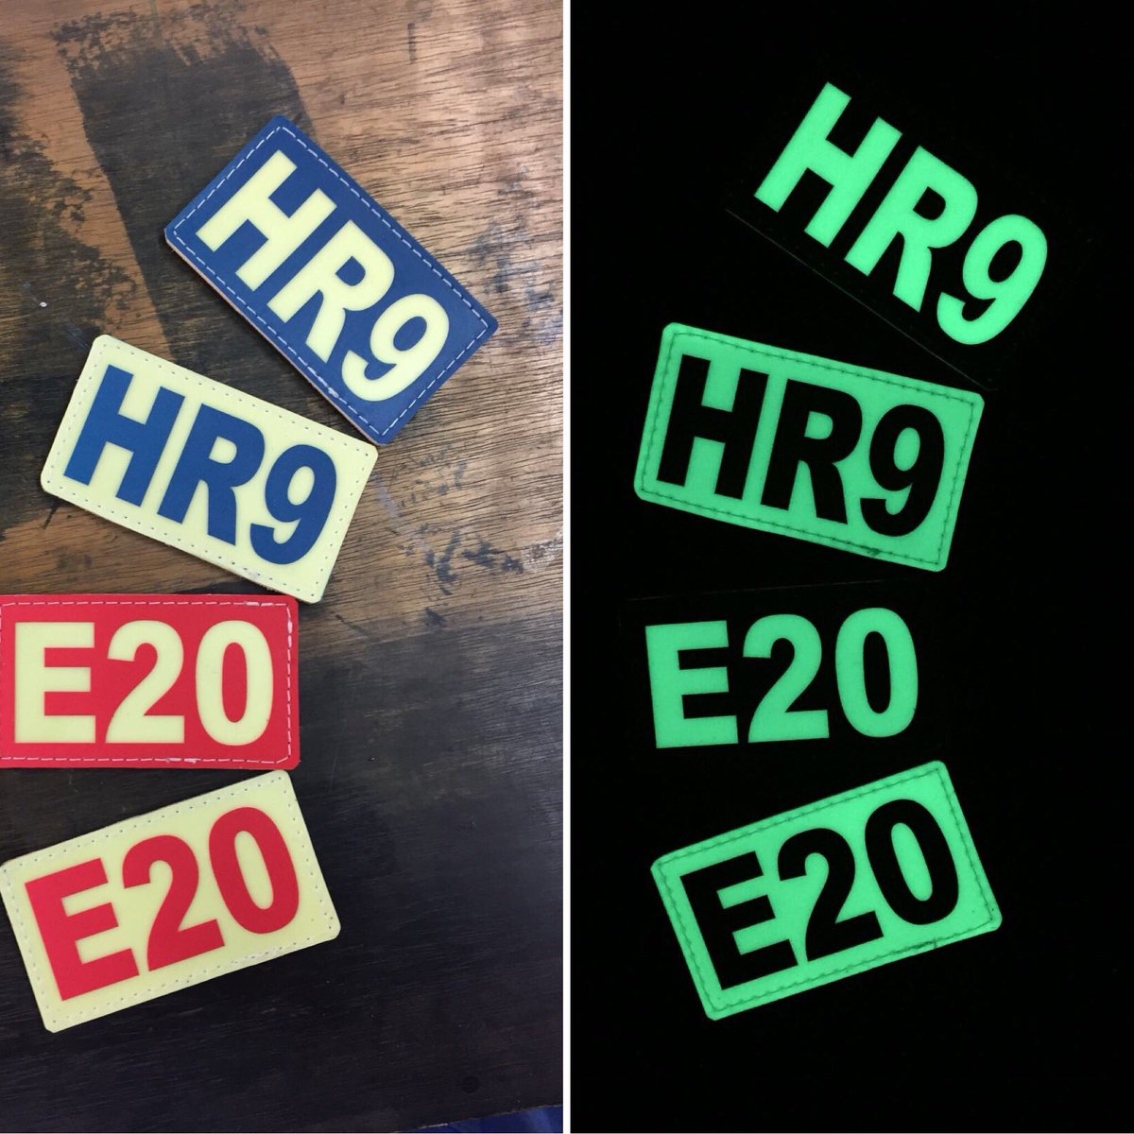
Shield Inserts
Unit Officer of the apparatus has White Background with colored letters.
Other Personnel of the apparatus have Colored Background with White letters.
All apparatus shall have shield inserts specific to that apparatus.
Jefferson County OG 16-10

Slide 17
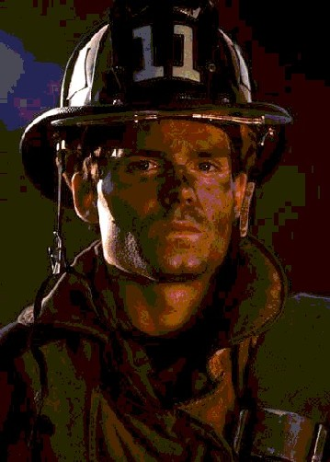
Who is this? What is his rank? Is he on Engine, Truck or Rescue Squad?

Slide 18
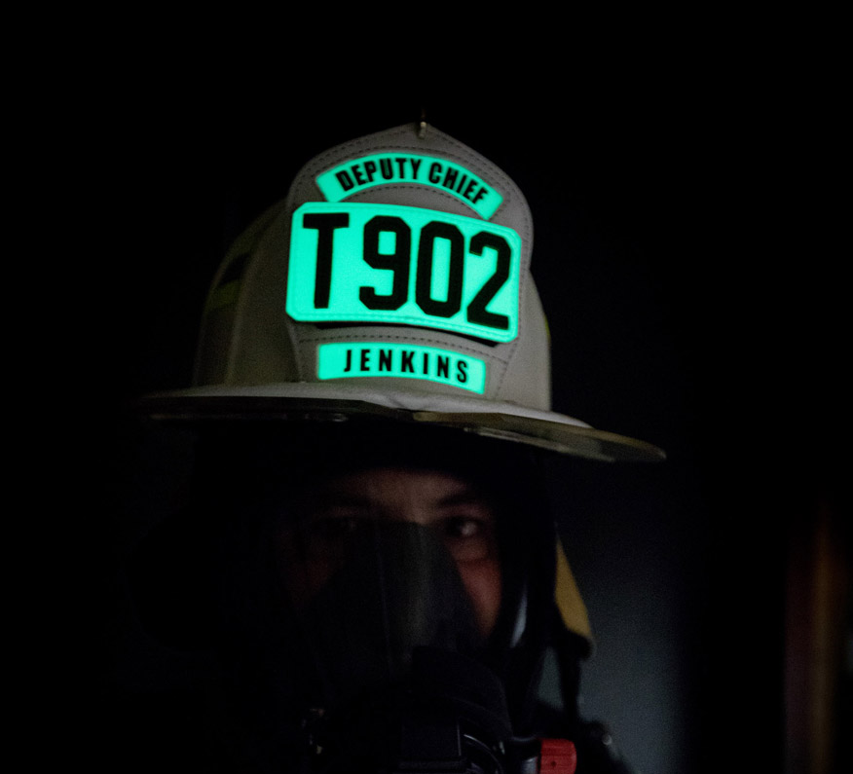
Who is this? What is his rank? Is he on Engine, Truck or Rescue Squad?

Slide 19
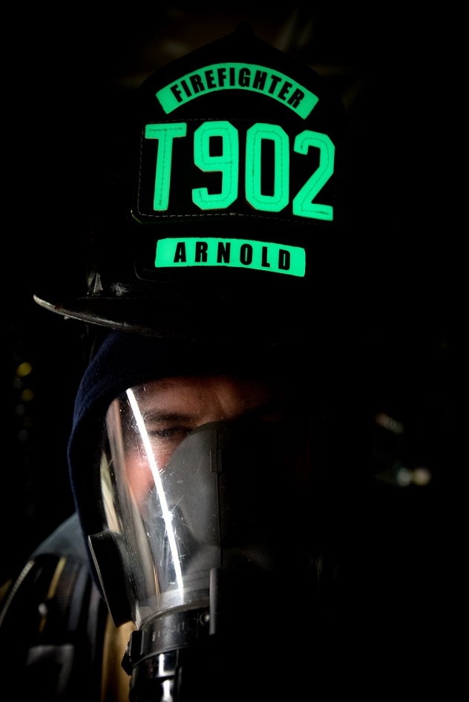
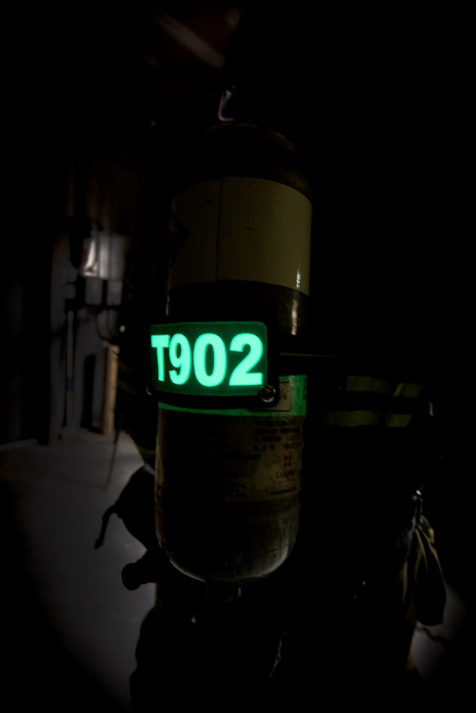
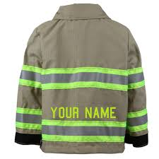
SCBA Identification
Front and Back Identification
  Helmet Shield and Insert
  Rear cylinder SCBA Identifier
  Name Plate on Coat

Slide 20
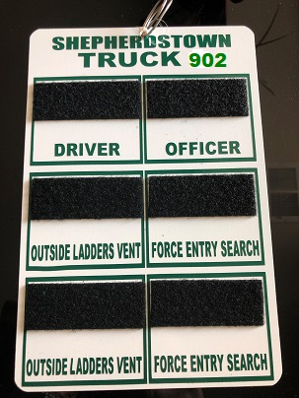
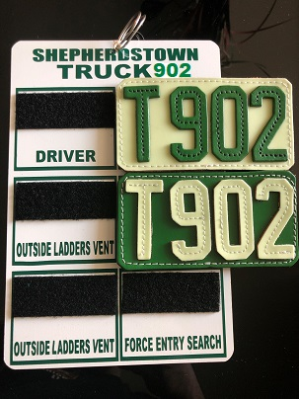
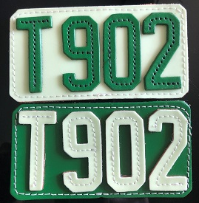
Accountability Boards
KEEP THE UNIT INSERTS ON THE PASSPORT BOARD
  Inserts for each seated position (extras are for POV’s arriving on scene)

Slide 21
System features and advantages
Jefferson County Fire and Rescue Association

Slide 22

Royce Shields is not required, so long as the shield meets OG.
https://www.youtube.com/watch?v=v5lB8uEtIPs

Slide 23
Emergency Scene Procedures
Jefferson County Fire and Rescue Association

Slide 24

Firefighter
All Jefferson County fire companies responding and/or on scene of an emergency incident shall use the Jefferson County Accountability System.
All personnel riding a specific apparatus, shall affix their Accountability Identification to the Accountability Board for that unit in their designated riding position, and shall affix a unit specific shield insert onto their helmet shield.
  If a unit responds driver only, the driver will always wear the driver helmet front, and will always place his/her Accountability Identification in the designated driver position. On Driver Only units, the driver remains responsible for the completion of the process.
  The use of the officer helmet front is for the designation of the unit officer, this rider may or may not be a company officer.
  All spare unit inserts remain on the board for future use by Command.

Slide 25
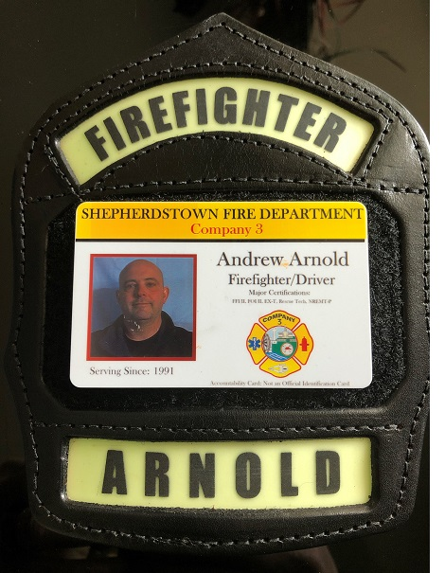
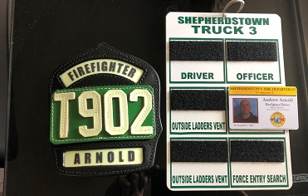
WHEN TAKING YOUR RIDING POSITION, SWITCH YOUR ID AND THE INSERT FOR YOUR RIDING POSITION

Slide 26
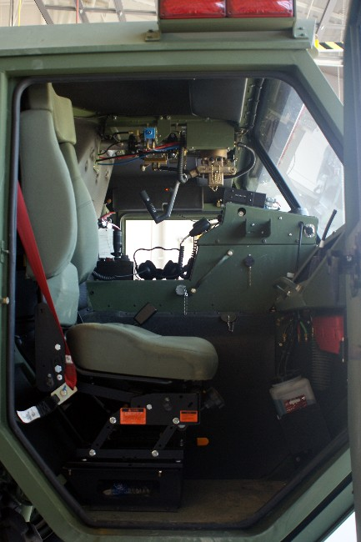
Firefighter
Upon arrival of the incident the unit officer will turn in the Accountability Board to Command, an accountability officer, or otherwise designated accountability personnel.
  In the event of a “Combat Command” situation where the first arriving officer is operating in a combat mode, the Accountability Board should be left on the front officer seat of the unit where the next arriving Command officer can easily locate the board.
  Command should consider a “runner” to collect boards.

Slide 27
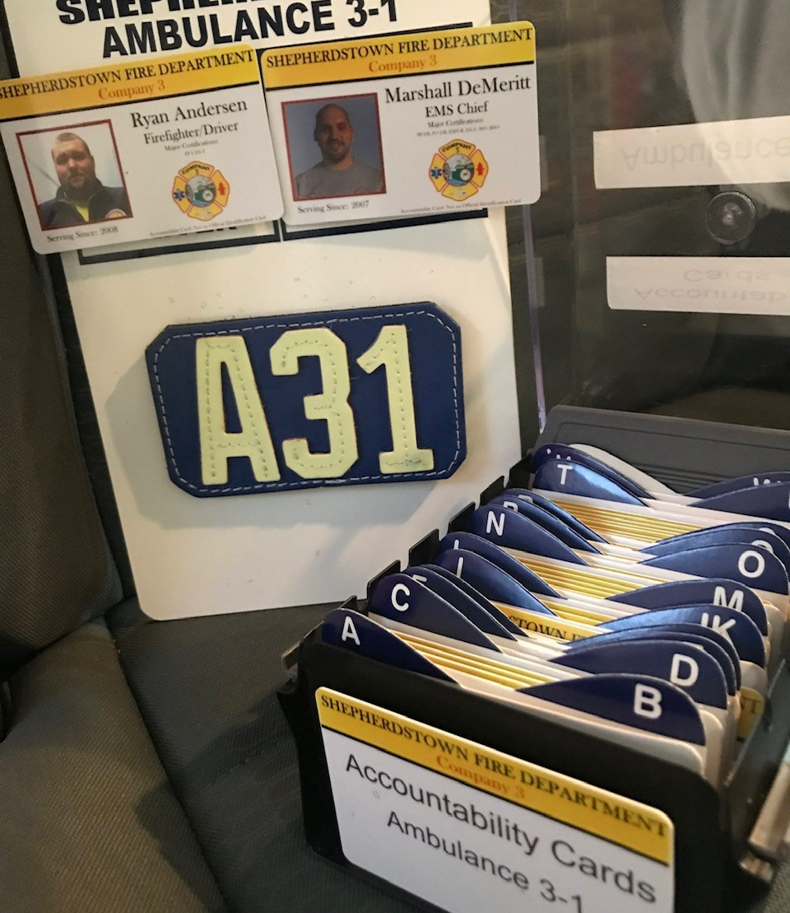
EMS Personnel
To enhance accountability and to improve tracking of Emergency Medical personnel on emergency scenes, all Jefferson County EMS personnel shall utilize the Accountability System any time incident command is established on an incident.

Slide 28
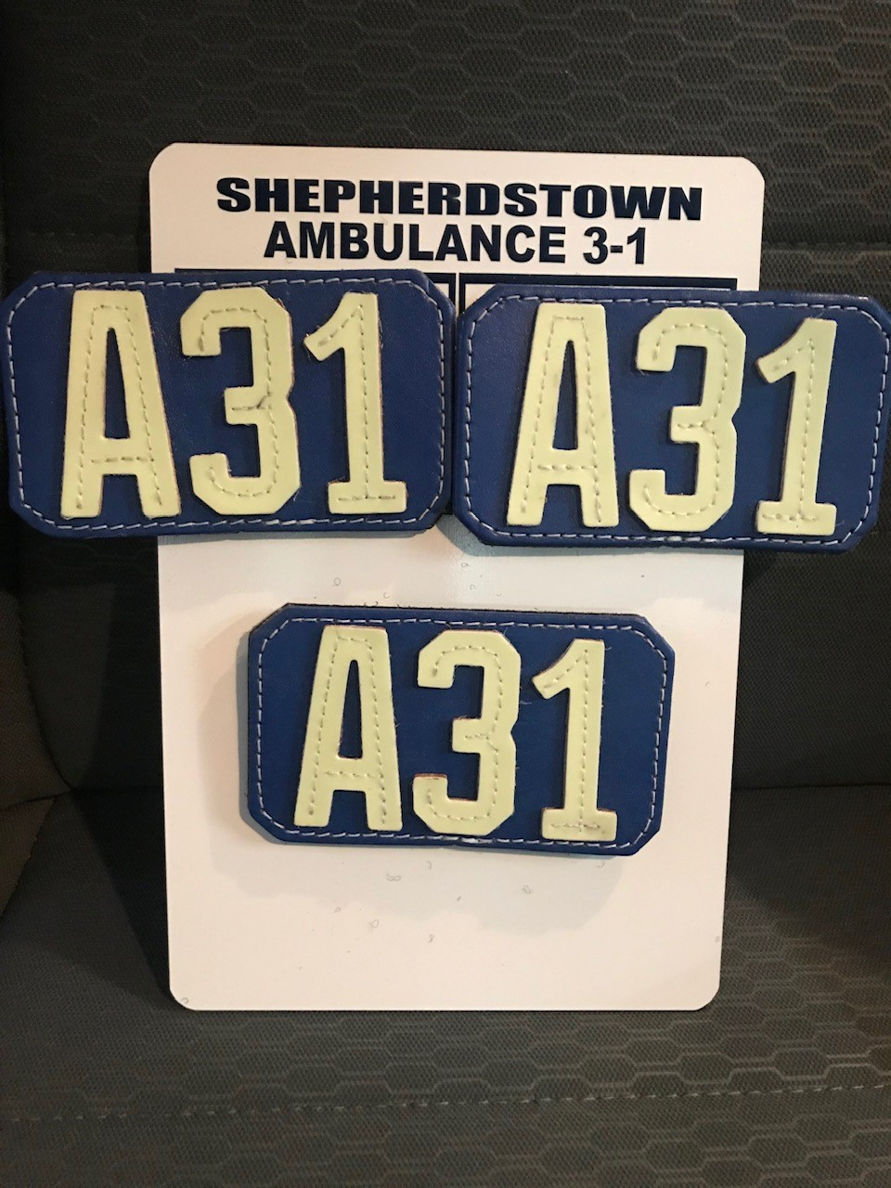
EMS Personnel
Each EMS operational member will be issued an “Accountability Identification.”
Each EMS apparatus will have an “Accountability Board” on which a helmet front specific to that unit will be affixed for each riding position: Driver, Attendant and one Assistant.
Once seated and buckled, the Attendant (or personnel in front right seat) will affix the Accountability Cards for all personnel on the EMS unit.
  Personnel that have issued fire gear should have fire gear with them, and they should have removed their Accountability Identification from their helmet prior to boarding the unit.
Affix the Accountability Identification in the associated riding position on the Accountability Board.
  If the unit is driver only, and/or no attendant is aboard, the Attendant riding position should NOT have an Accountability Card affixed.

Slide 29
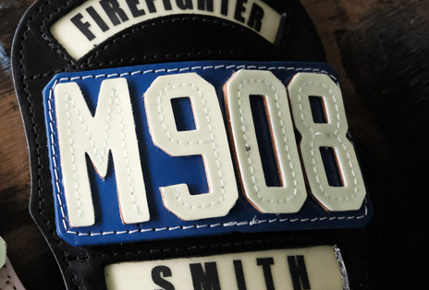
EMS Personnel
Those EMS personnel operating within an IDLH (or potentially operating within an IDLH) shall affix the helmet front to their assigned unit, and shall wear the helmet for the duration of the incident, as applicable.
Upon arrival of the incident the DRIVER will turn the Accountability Board into command, an accountability officer or otherwise designated accountability personnel.
In the event of an immediate need for EMS, the Accountability Board should be left on the front passenger seat of the unit where the next arriving Command officer can easily locate the board.

Slide 30
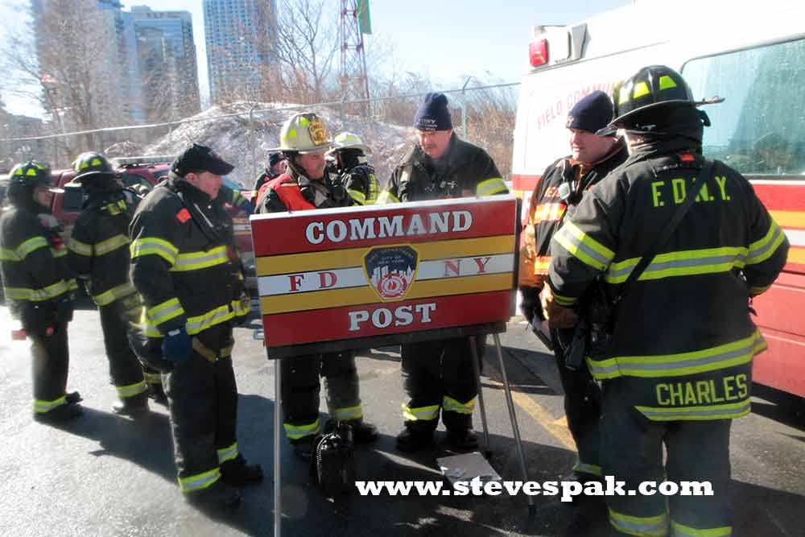
POV Response
Individual firefighters arriving via personal vehicle shall report to the Command Post, with all appropriate gear, and have their Accountability Identification.
The Incident Commander will assign a Helmet Front of your newly designated riding assignment, and will affix your Accountability Identification to that spot on the Accountability Board.
  The unit to which you are assigned, may NOT be that of your home company.
No member (Fire or EMS) shall enter operational deployment without first reporting to the IC or designated accountability officer, and being assigned a helmet front/unit assignment.

Slide 31
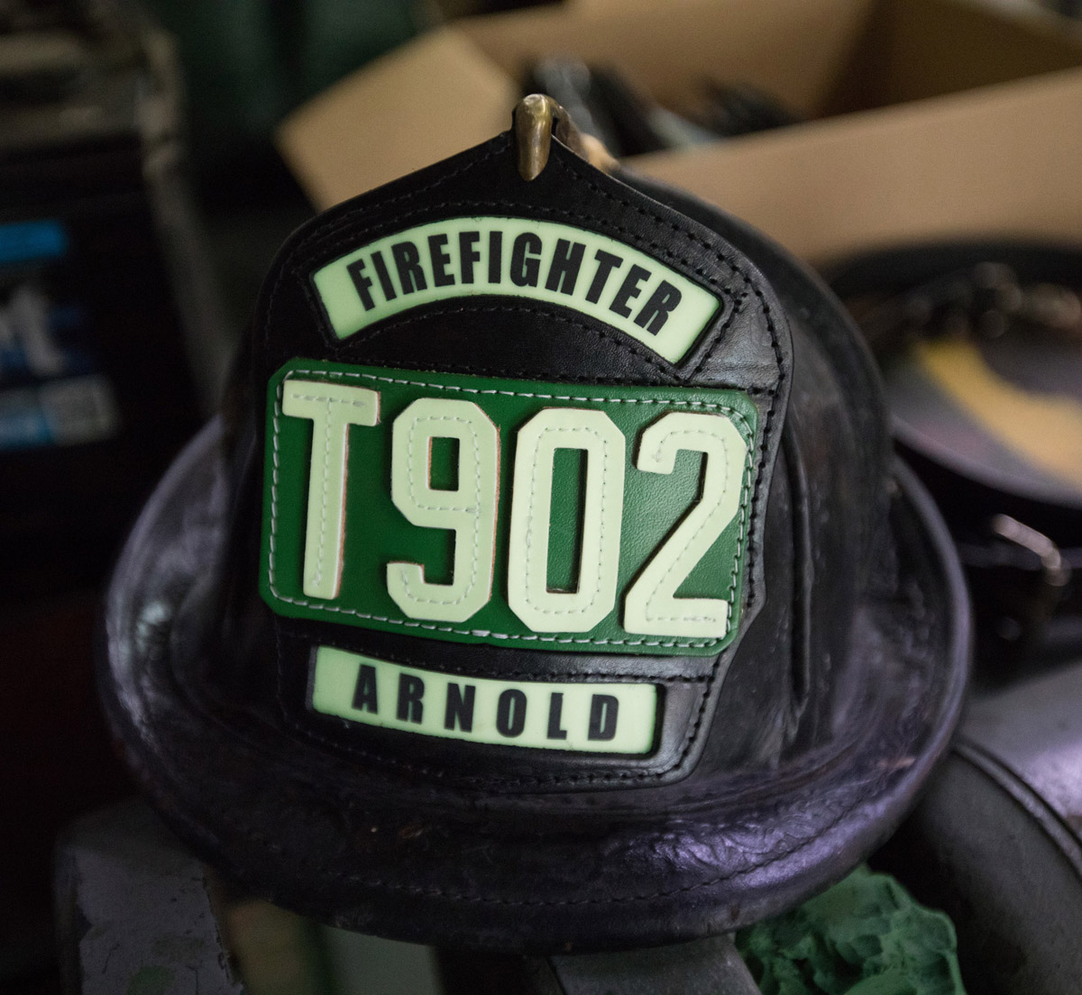
IF YOU SEE A FIREFIGHTER ON THE FIREGROUND
WITH THIS
THIS
INSTEAD OF
YOU KNOW IMMEDIATELY HE/SHE IS NOT PROPERLY ACCOUNTED FOR AND IS POSSIBLY FREELANCING

Slide 32
Terminating Accountability
Jefferson County Fire and Rescue Association

Slide 33
Termination of Accountability
Accountability will be maintained at least until the IDLH environment has been mitigated. The Accountability Boards should be retained by Command until Command is terminated and/or the unit has been released.
When the unit is released, it is the responsibility of the Unit Officer or Ambulance Driver to obtain the Accountability Board for that unit.
The Accountability Boards should remain intact until the unit has completely returned to the station, and personnel are getting off the unit, and/or no new emergency response is indicated.
Upon release from the unit, the officer and crew must make certain the helmet fronts are returned to the Accountability Board, the Accountability Identifications are returned, and the Accountability Board is replaced in the unit ready for the next call.
If a member leaves the scene prior to the unit, they must return their helmet front, and have their Accountability Identification removed from the Accountability Board.

Slide 34
Next Steps
Have all Helmet Shields installed.
Install SCBA Identifiers.
Have all personnel Accountability ID cards printed
  (JCESA, Station 4, Station 3)
Place Unit Inserts on Accountability Boards, and place in apparatus – make sure officer insert it correctly placed.
Train and Manage your personnel in the use of the system
  Always Use The System! It’s a necessary habit.
In Progress: Command Board Integration

Slide 35
Questions
?

